Slide 1
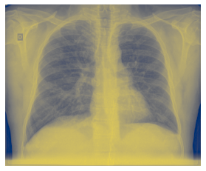
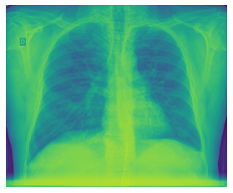
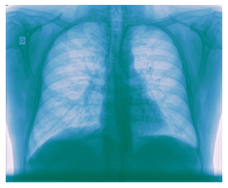
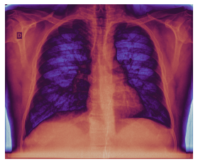
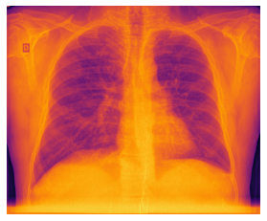
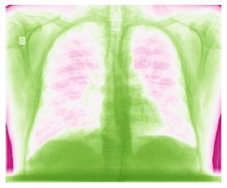
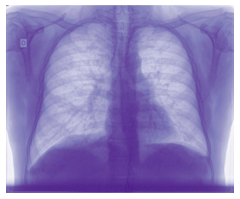
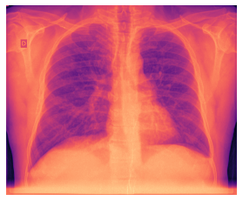
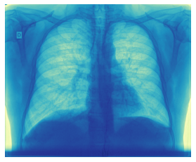
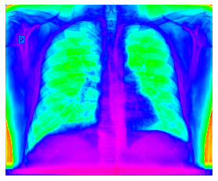
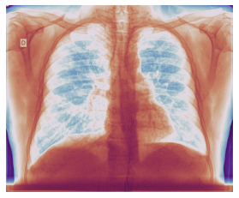
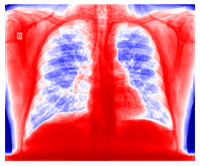

Slide 2
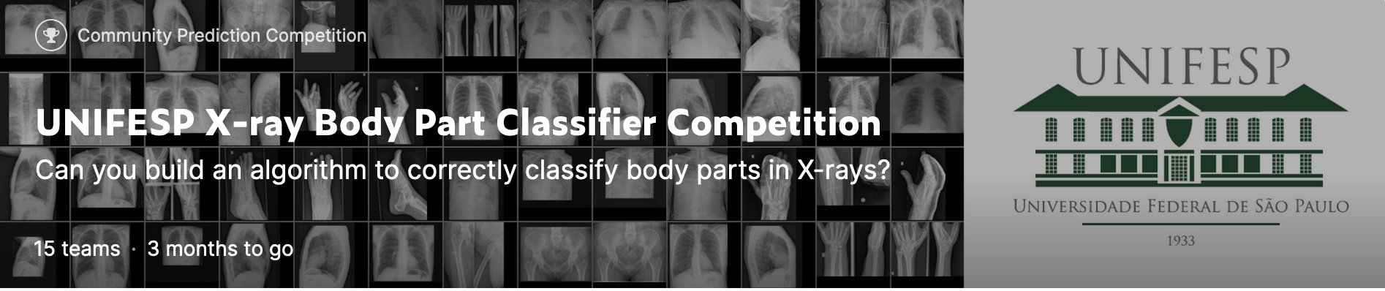
Link: https://www.kaggle.com/competitions/unifesp-x-ray-body-part-classifier
Objective:
to predict the body part from a given X-ray
Data:
Sets of images in DICOM format;
train.csv file, with the following information :
‘SOPInstanceUID’: image identification (from metadata)
‘Target’: label (body part)

Slide 3
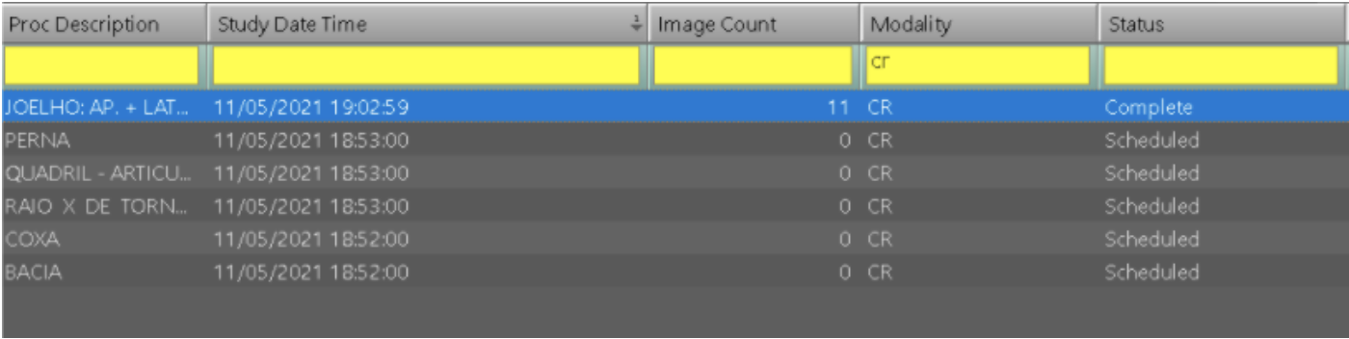
Why solving this problem matters?

Slide 4
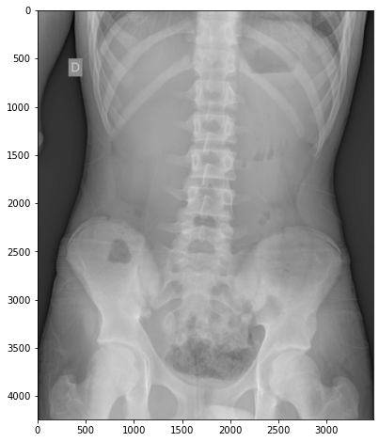
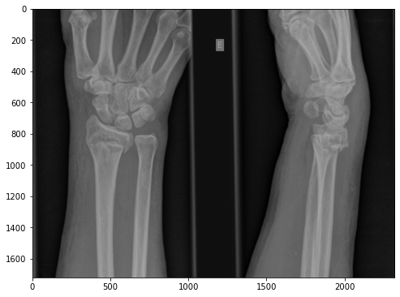
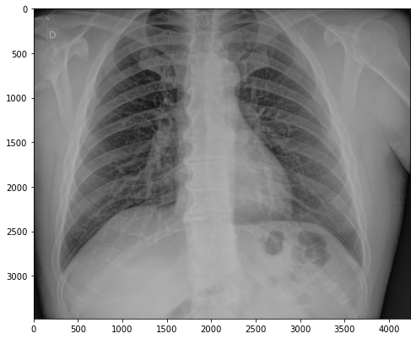
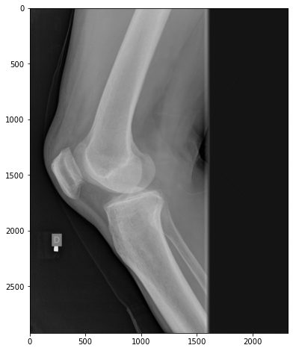
It should be a very simple task…
Abdominal
Wrist
Chest
Knee

Slide 5
… but several challenges are in the way
Heavy files (train image files approx. 22GB):
How to store the transformed images (numpy arrays)
Load and read the image inside the interface:
type of image files (DICOM)
decoder (pydicom)
Image contrast display
Matching image ID, label from dataframe with image itself
Image sizing
Transformation and classification algorithms for images

Slide 6
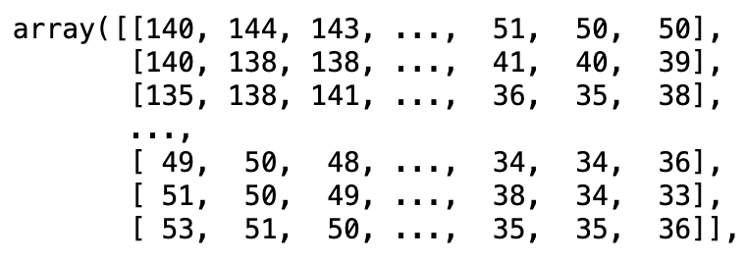


The Basic Principle:

Slide 7
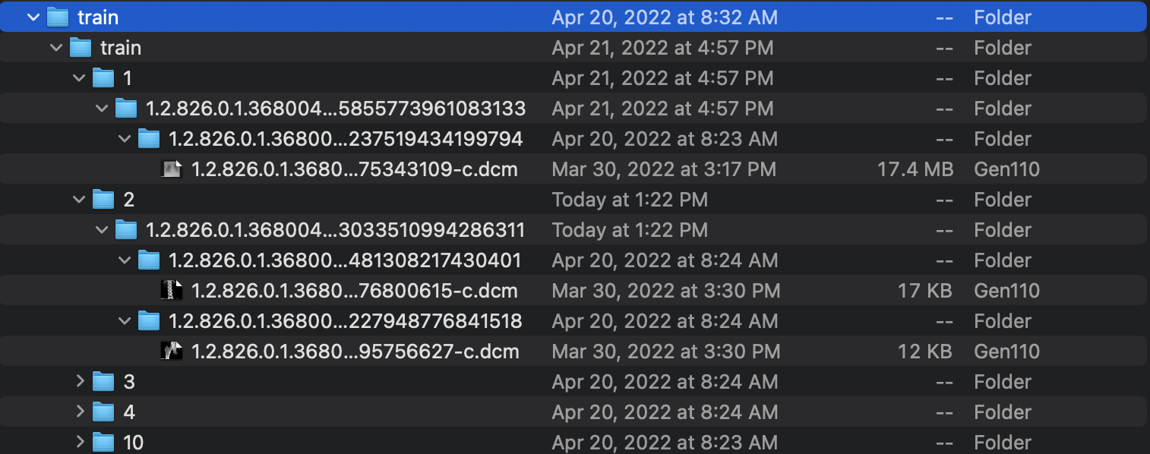
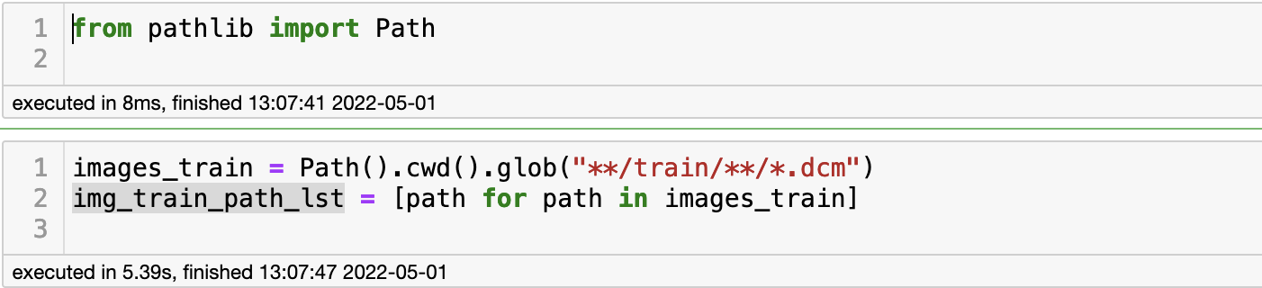
Image loading and visualization

Slide 8
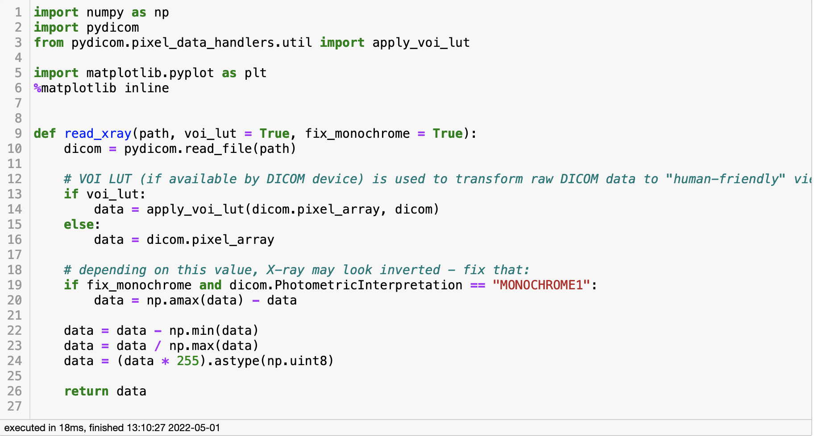
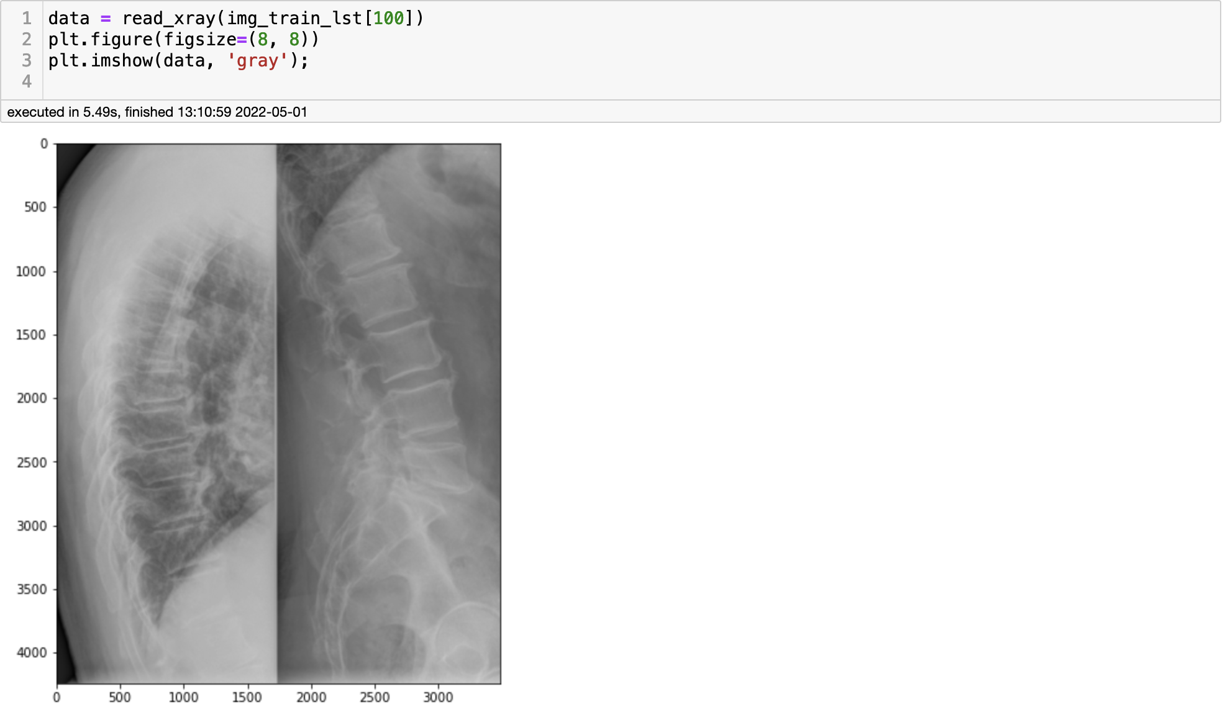
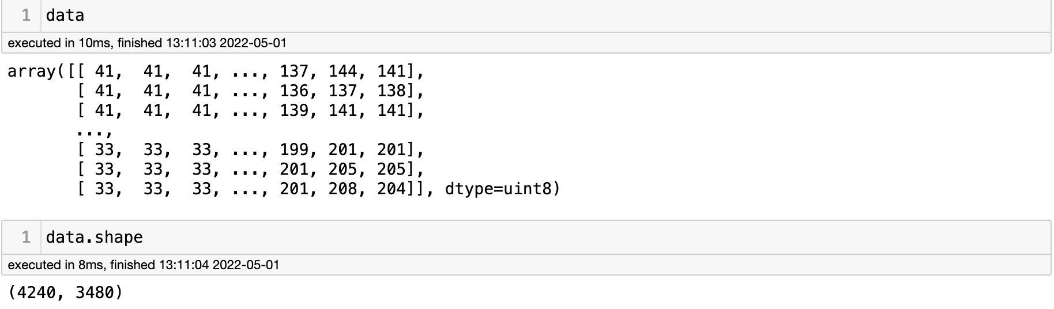
Image loading & visualization

Slide 9
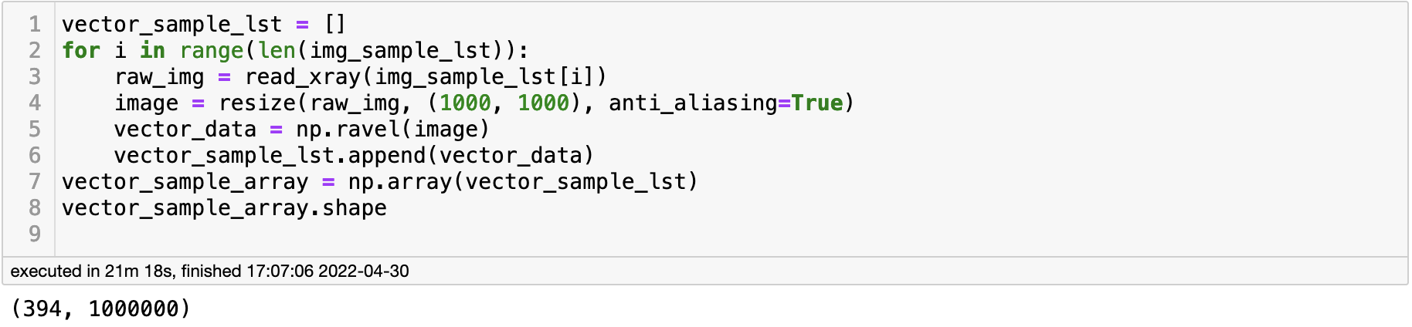
Vectorizing
Resizing (1000 x 1000)
Matrix to Vector
# images
(rows)
columns
Transform list into a numpy array

Slide 10
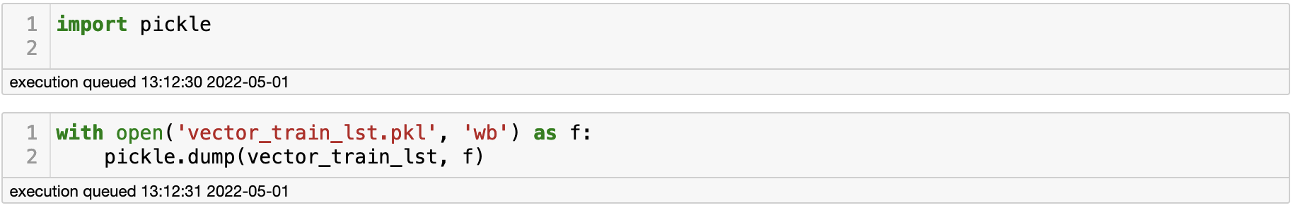
Saving the variables (Pickle file)

Slide 11
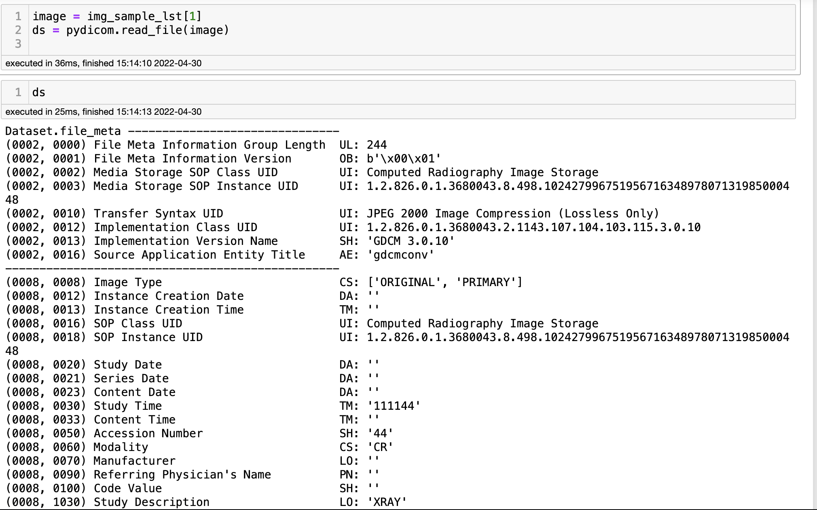
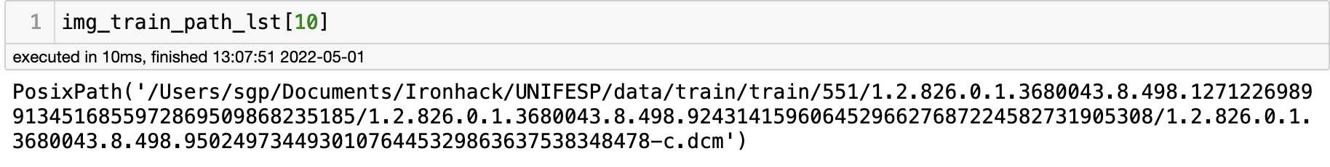
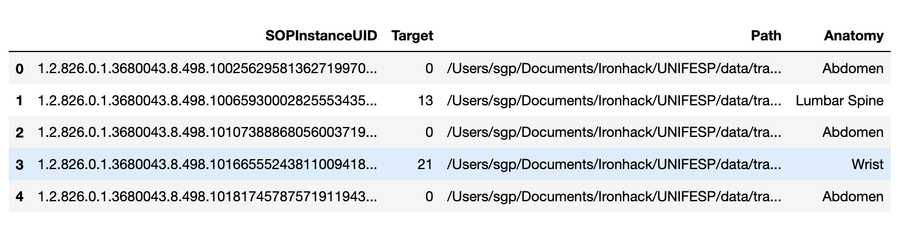
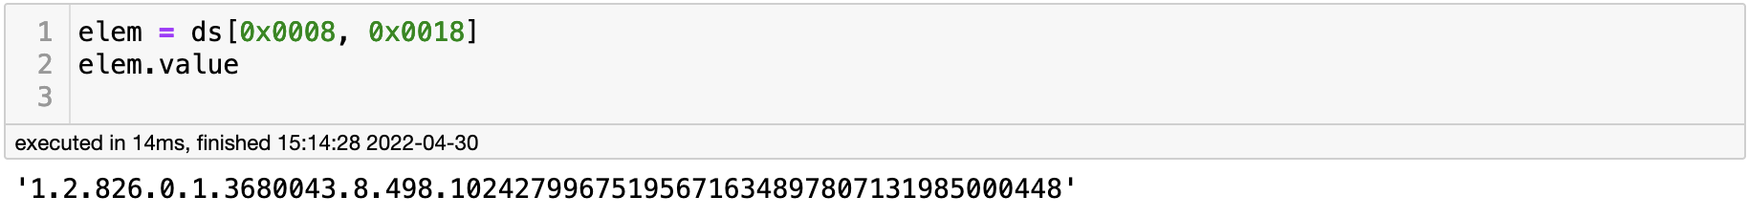
Building final dataframe

Slide 12
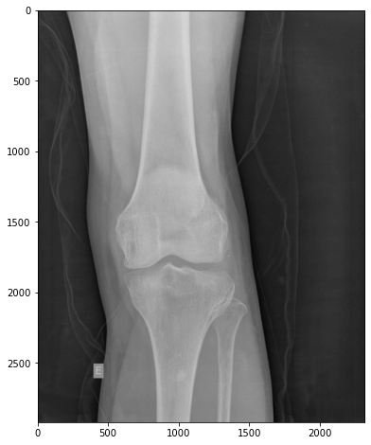
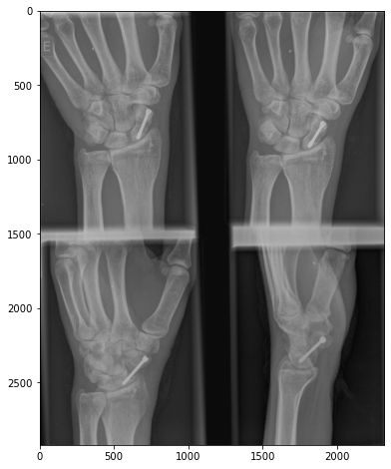
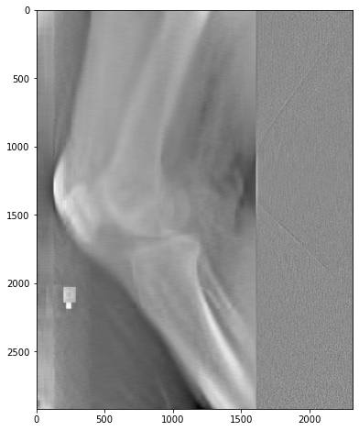
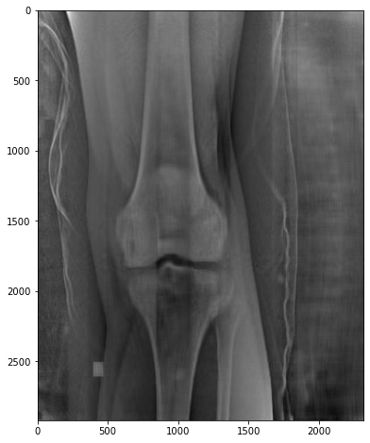
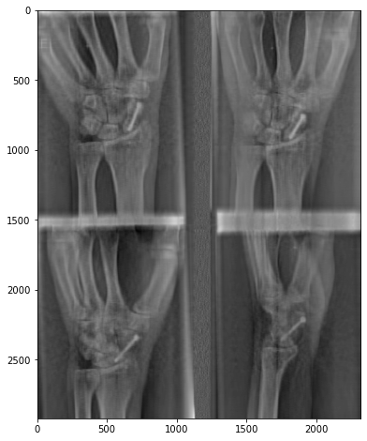
PCA
Original images
(2920 x 2320)
PCA (n_components=50)
(2920 x 50)

Slide 13
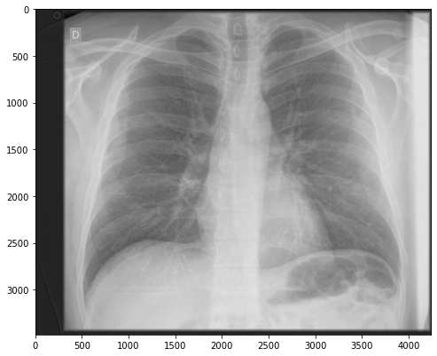
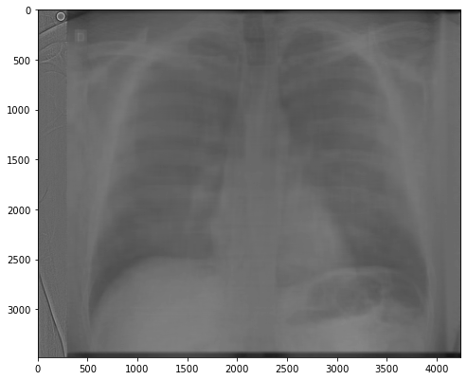
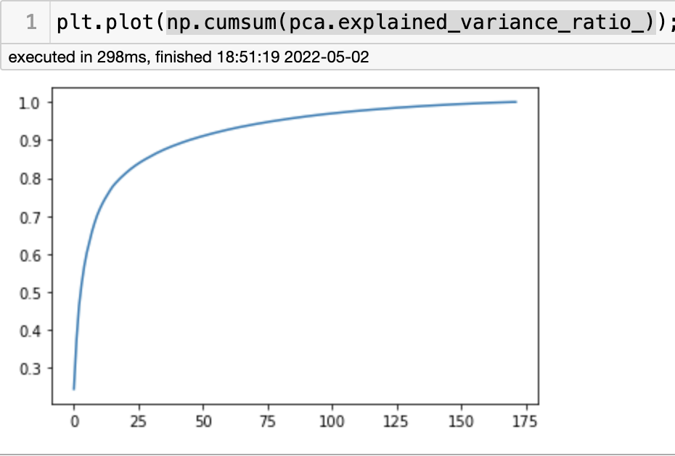
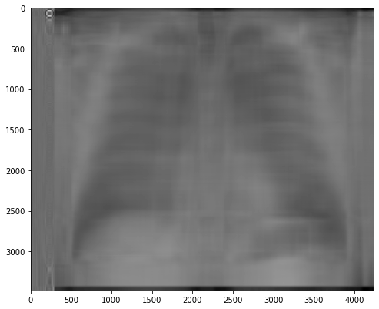
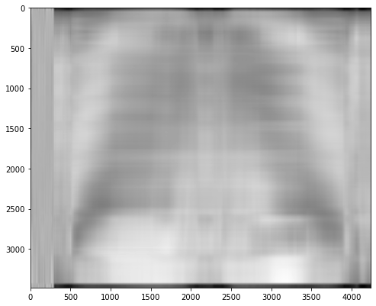
PCA
Original
PCA 50
PCA 10
PCA 5

Slide 14
Original
PCA 50
PCA 10
PCA 5

Slide 15
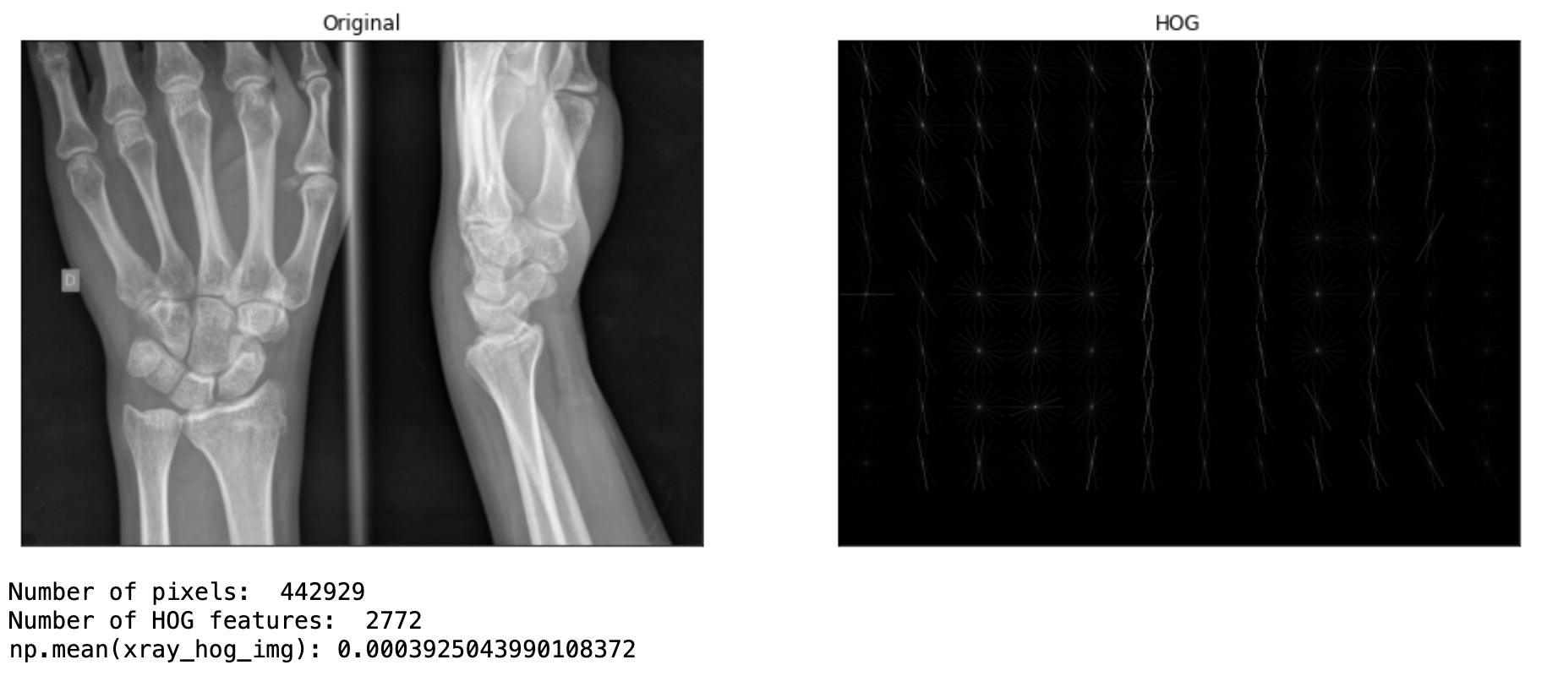
Histogram of Oriented Gradients (HOG)

Slide 16
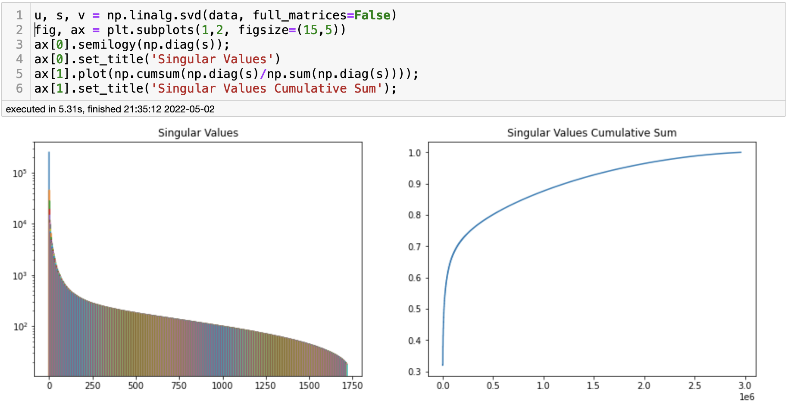
Singular Value Decomposition (SVD)

Slide 17
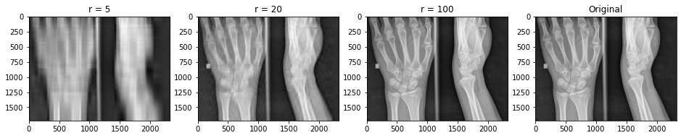
Singular Value Decomposition (SVD)

Slide 18
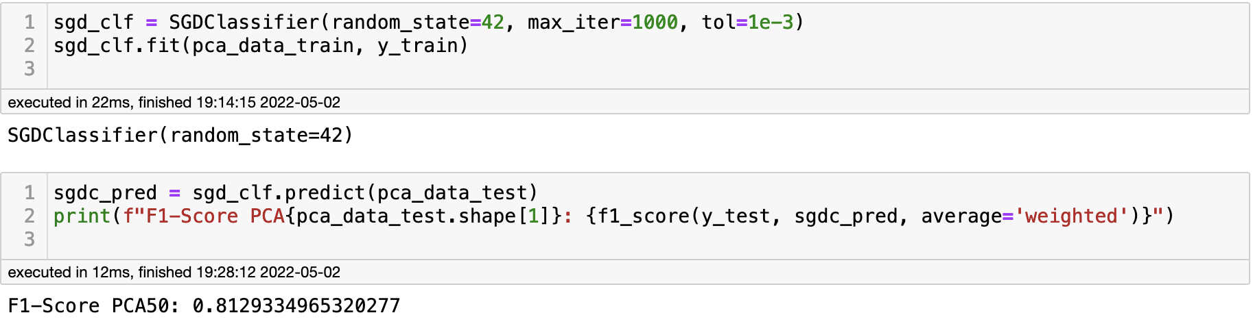
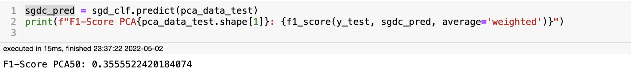
Models (Classifier)
Stochastic Gradient Descent (SGD)
Sample: 2 labels (knee and wrist)
Sample: 6 labels (knee and wrist)

Slide 19
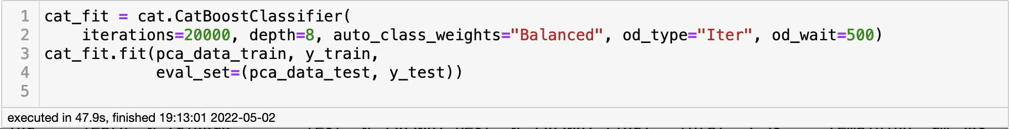
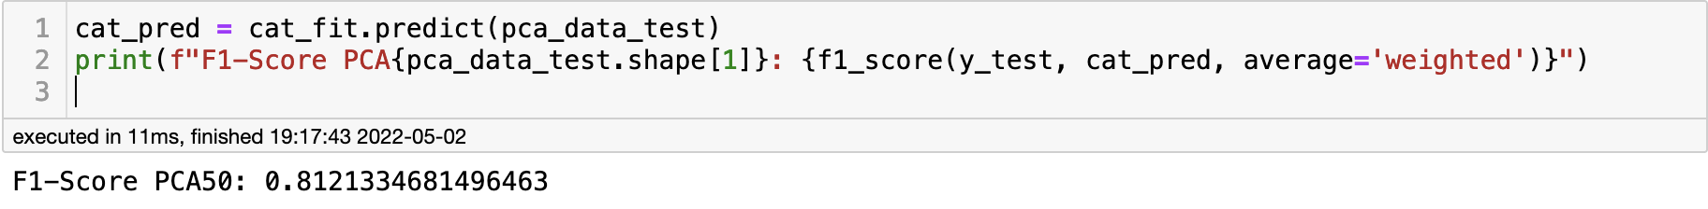
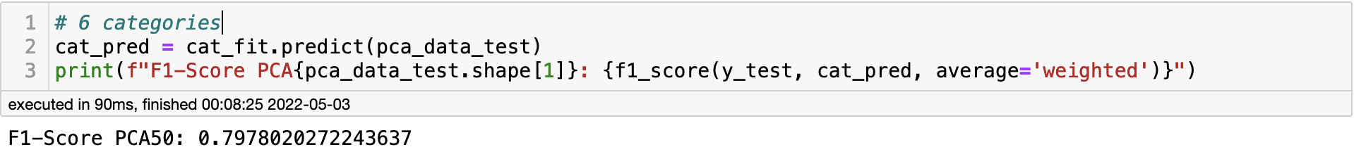
Models (Classifier)
CatBoost
Sample: 2 labels (knee and wrist)
Sample: 6 labels (knee and wrist)

Slide 20
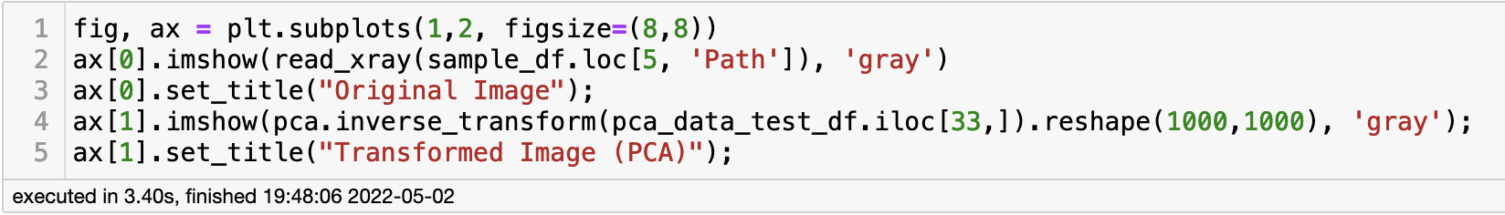
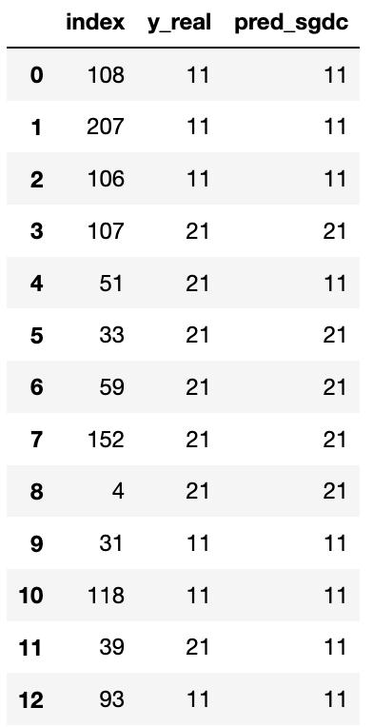



Models (Classifier)

